Slide 1
South America
Overview

Slide 2
South America Location
Located in the Western Hemisphere and mostly in the Southern Hemisphere.
Bordered on the west by the Pacific Ocean and on the north and east by the Atlantic Ocean.
Also bordered by the North America and the Caribbean Sea to the northwest.

Slide 3
South American Countries
Argentina
Bolivia
Brazil
Chile
Colombia
Ecuador
Guyana
Paraguay
Peru
Suriname
Uruguay
Venezuela
French Guiana

Slide 4
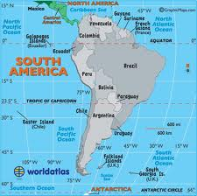
Map of South America

